Slide 1


Machine learning based visual style advisor for personalized fashion and beauty recommendations
24-25J-155
Progress Presentation 1
2/12/2024

Slide 2
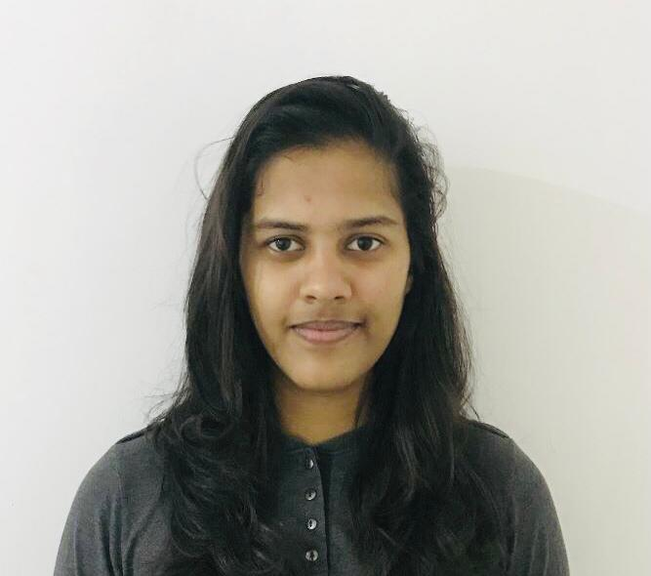


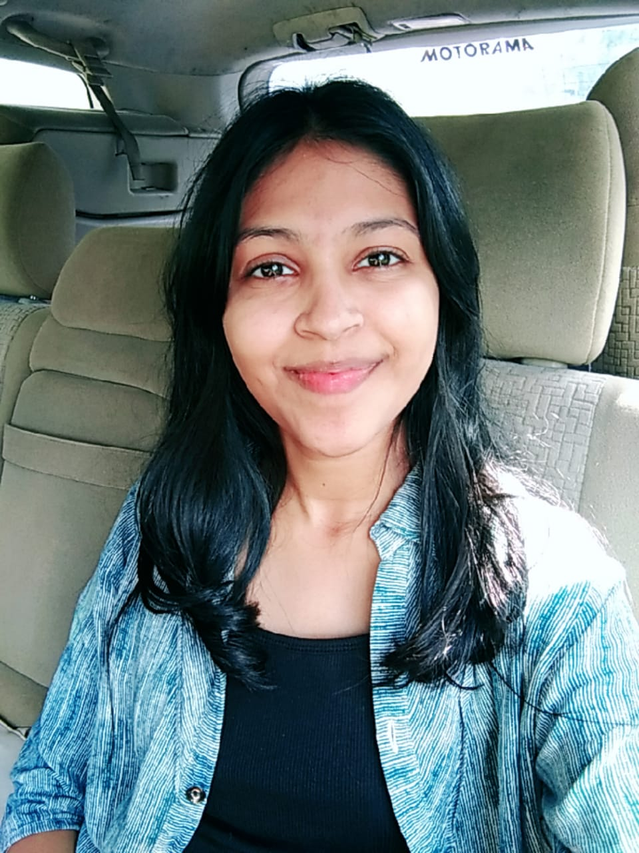

Meet Our Team !
Prasadi S.A.D.T.
IT21894824
Shaakir J.H.M.
IT21322280
Vikasitha M.K.I.
IT21180798
Senarathne D.R.
IT21213144
2/12/2024

Slide 3
INTRODUCTION
In an era where personalization is key to enhancing user experience.
The integration of machine learning into fashion and beauty has paved the way for tailored recommendations that cater to individual preferences.
This project, "Machine Learning Based Visual Style Advisor," leverages advanced techniques such as hair style and color simulation, virtual fit-on for clothing, and skin tone identification.
The goal is to offer personalized fashion and beauty advice.
By combining these elements, the system provides users with a comprehensive and interactive platform.
The platform enhances their personal style with precision and ease.
2/12/2024

Slide 4
RESEARCH QUESTION
How can machine learning enhance the personalization of hair color and hairstyle simulations to align with individual preferences and facial features?
What impact does real-time virtual fit-on technology have on user satisfaction and confidence in clothing recommendations?
In what ways can skin tone identification and makeup recommendation algorithms be optimized to provide more accurate and holistic beauty suggestions?
How do current recommendation systems fall short in integrating comprehensive hair color and style advice, and how can these limitations be addressed through advanced AI techniques?
What role do trends and peer influence play in young individuals' decision-making processes, and how can personalized guidance counterbalance these external pressures?
2/12/2024

Slide 5
OBJECTIVES
Main Objective
Sub Objectives
To develop a highly effective machine learning based personalized fashion and beauty recommendation system for the young generation. This system aims to address the current challenges individuals face when selecting hairstyles, hair colors and skin tone identification & makeup without personalized guidance. And also, to develop a clothing recommendation tool with virtual fit-on with enhanced features.
Hair Style Transformation and Realistic Simulation for Personalized Recommendations
Personalized Hair Color Recommendation Using Deep Learning
Clothing Recommendation based on body type & skin tone
Skin Tone Identification and Makeup
Recommendations
2/12/2024

Slide 6
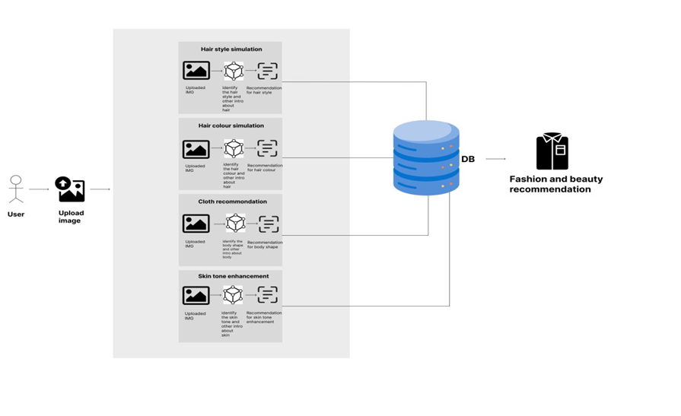
System Diagram
2/12/2024

Slide 7
IT21894824 | Prasadi S.A.D.T.
Specialization : Information Technology
IT21894824 | Prasadi S.A.D.T. | 24-25J-155
2/12/2024

Slide 8
Personalized Hair Color Recommendation Using Deep Learning
IT21894824 | Prasadi S.A.D.T. | 24-25J-155
2/12/2024

Slide 9
Introduction
Background
The rise of deep learning and image processing technology has enabled the development of personalized hair color recommendation systems, allowing users to visualize potential hair color changes in real-time based on their unique features.
Many hair color recommendation systems utilize machine learning models, particularly convolutional neural networks (CNNs), to analyze individual traits such as skin tone, eye color, and natural hair color, providing tailored suggestions that enhance user satisfaction.
Traditional hair color selection tools often limit users to predefined palettes with minimal customization. In contrast, modern systems offer more in-depth personalization, considering lifestyle factors, preferences, and professional feedback to suggest hair colors that are uniquely suited to each user.
IT21894824 | Prasadi S.A.D.T. | 24-25J-155
2/12/2024

Slide 10
How can deep learning techniques be leveraged to develop a personalized hair color recommendation system that accurately integrates individual features such as skin tone, eye color, natural hair color, and lifestyle preferences, while offering interactive visualization tools for enhanced user engagement and satisfaction?
Research Problem
IT21894824 | Prasadi S.A.D.T. | 24-25J-155
2/12/2024

Slide 11
Specific and Sub Objective
Sub Objectives
Specific Objective
Implement data augmentation techniques to improve model generalization and normalize data for consistent input to CNN models.
Use transfer learning by fine-tuning pre-trained CNN models for specific attributes like skin tone and hair condition.
Create an intuitive front-end interface that allows users to upload images, input preferences, and interact with the recommended hair color.
Set up a robust backend infrastructure for processing images, running model inference, and integrating user data with the recommendation system.
Optimize the system for real-time processing and ensure it can scale effectively to support an increasing number of users while maintaining performance.
Personalized Hair Color Recommendation Using Deep Learning
IT21894824 | Prasadi S.A.D.T. | 24-25J-155
2/12/2024

Slide 12
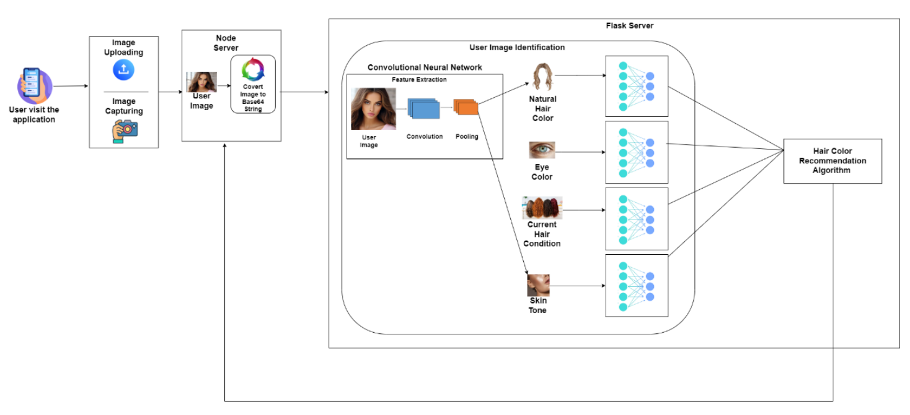
Methodology
System Diagram
IT21894824 | Prasadi S.A.D.T. | 24-25J-155
2/12/2024

Slide 13
Technologies,Techniques & Algorithms
Algorithms & Architectures
Technologies
Techniques
React Native
Expo
Python
Jupyter Notebook
Google Colab
Flask Server
Node Server
OpenCV
Intellij Idea
Data Preprocessing
Data Augmentation
Data Visualization
CNN
Image processing
Transfer learning
Algorithm tuning
IT21894824 | Prasadi S.A.D.T. | 24-25J-155
2/12/2024

Slide 14
Completion of the components
IT21894824 | Prasadi S.A.D.T. | 24-25J-155
2/12/2024

Slide 15






Methodology
Tuning hyper-parameters and retrained models to select the best architecture
Data collection
Data pre-processing
Data Visualization
Used transfer learning based Convolutional Neural Network(CNN) architectures for training models
Host the finalized model in the flask server
Data augmentation and selected the
best technique to retrain models to achieve good fitting
Displayed the results in mobile application
IT21894824 | Prasadi S.A.D.T. | 24-25J-155
2/12/2024

Slide 16
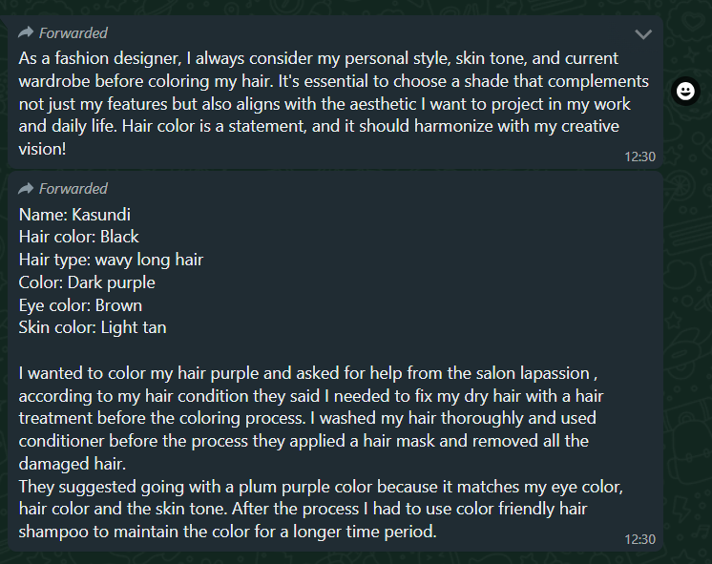
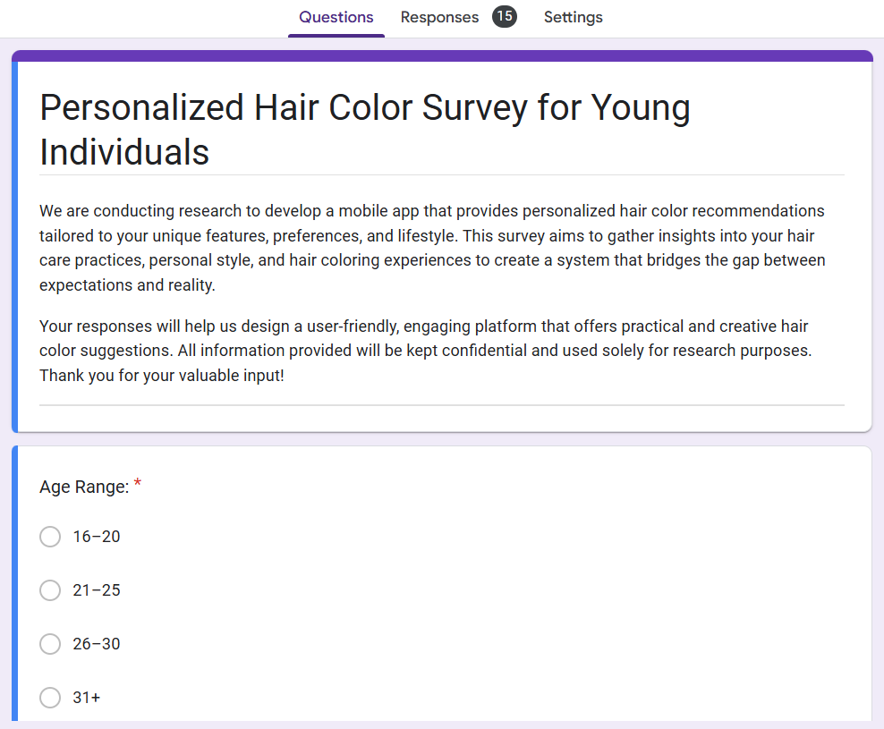
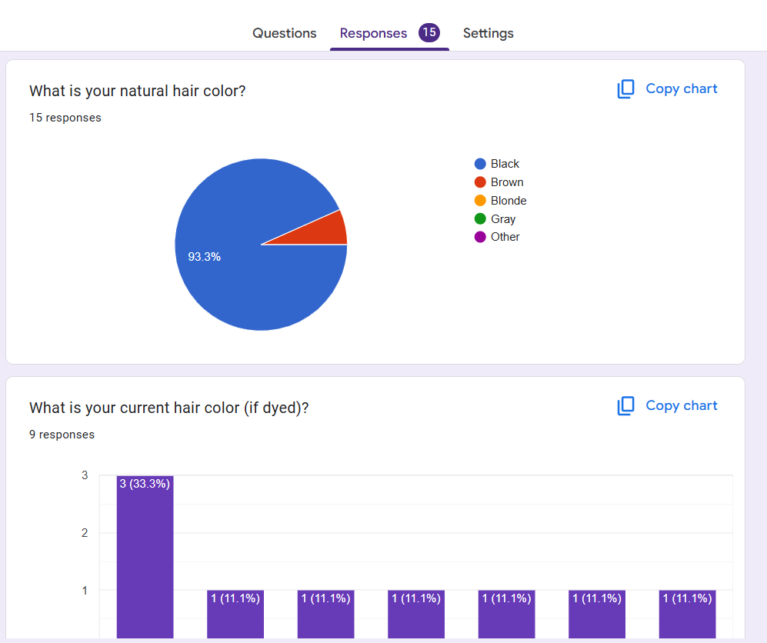
Methodology
Evidence of Completion
IT21894824 | Prasadi S.A.D.T. | 24-25J-155
2/12/2024

Slide 17
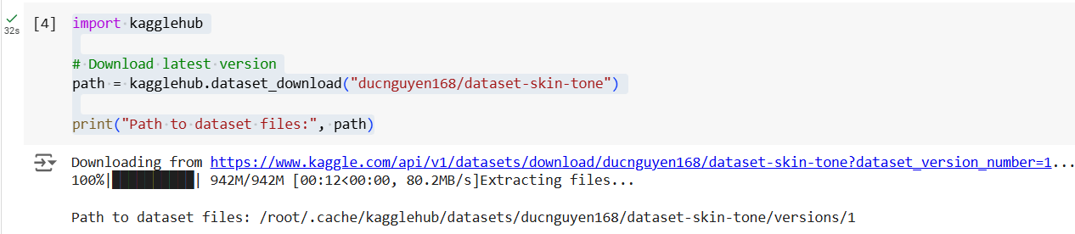
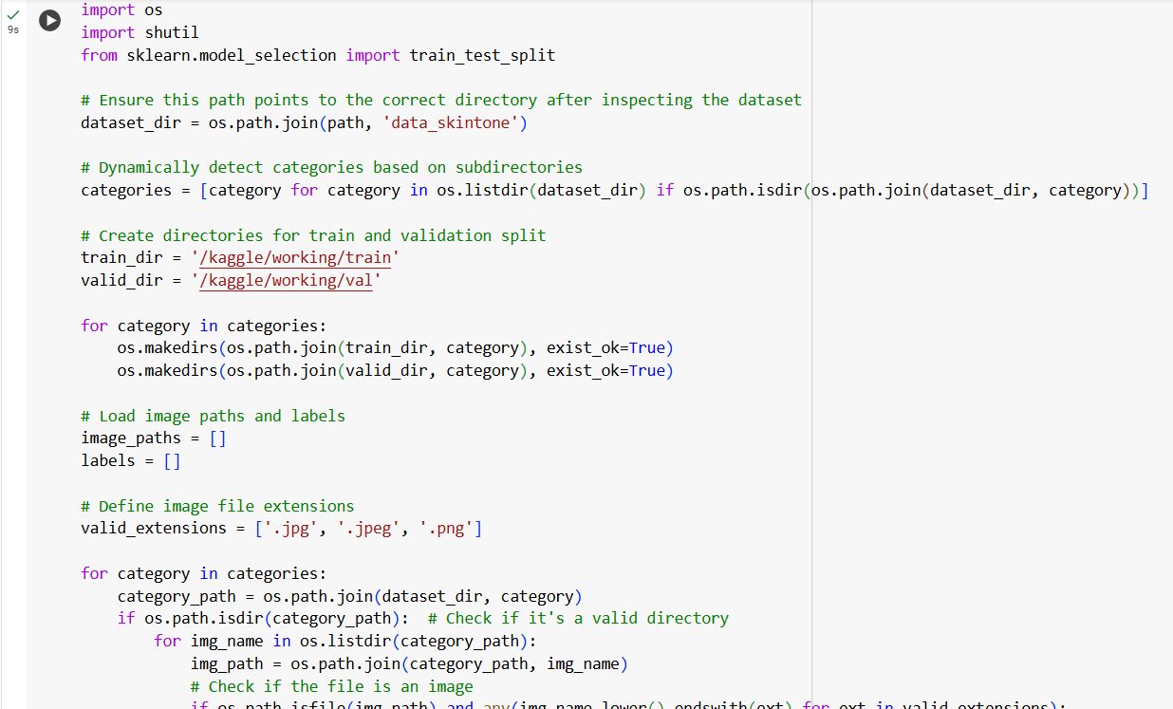
Methodology
Evidence of Completion
Skin Tone Classification
Used kagglehub to download the "Dataset Skin Tone."
Data pre-processing implemetation
IT21894824 | Prasadi S.A.D.T. | 24-25J-155
2/12/2024

Slide 18
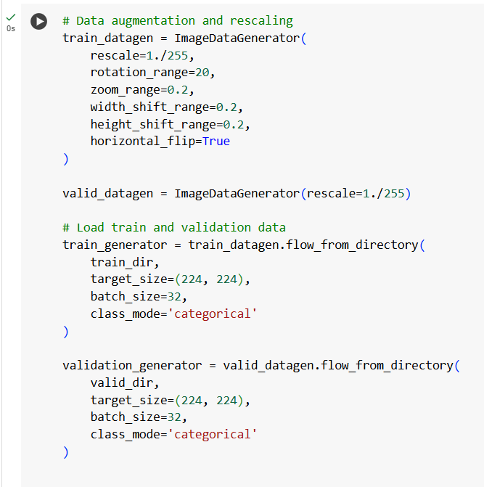
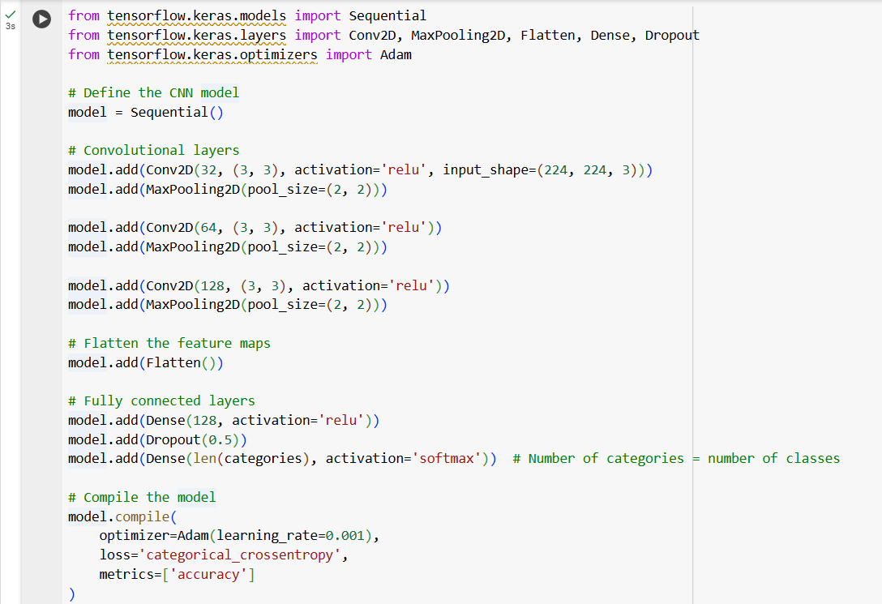
Methodology
Evidence of Completion
Skin Tone Classification
Data augmentation
Model Architecture
Built a CNN model with convolutional layers, pooling layers, and fully connected layers.
IT21894824 | Prasadi S.A.D.T. | 24-25J-155
2/12/2024

Slide 19
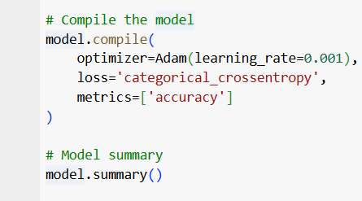
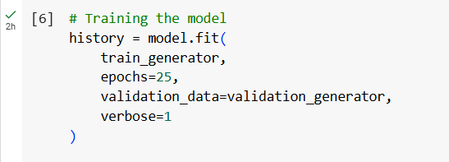
Methodology
Evidence of Completion
Skin Tone Classification
Trained the model for 25 epochs, monitoring validation performance.
Model Compilation
IT21894824 | Prasadi S.A.D.T. | 24-25J-155
2/12/2024

Slide 20
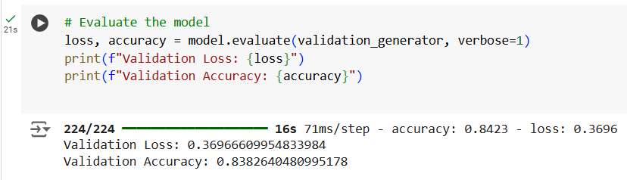
Methodology
Evidence of Completion
Skin Tone Classification
Model Evaluation
IT21894824 | Prasadi S.A.D.T. | 24-25J-155
2/12/2024

Slide 21
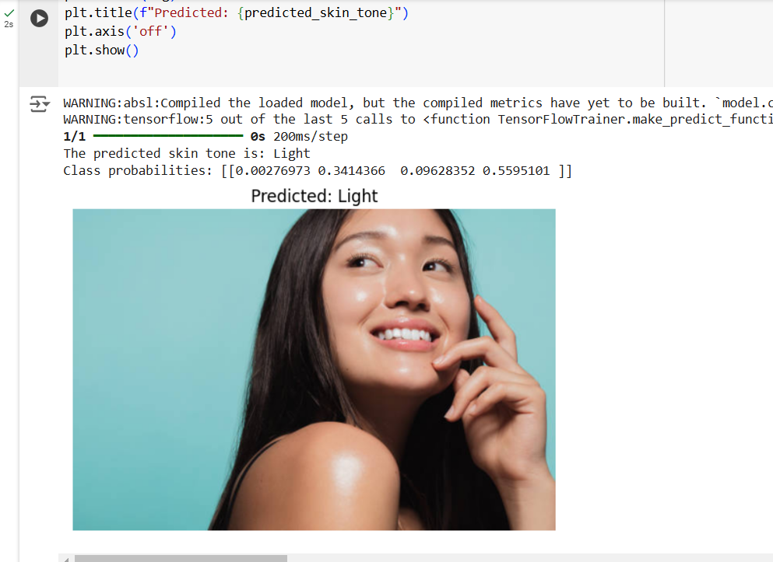
Methodology
Evidence of Completion
Skin Tone Classification
Skin Tone Prediction
IT21894824 | Prasadi S.A.D.T. | 24-25J-155
2/12/2024

Slide 22
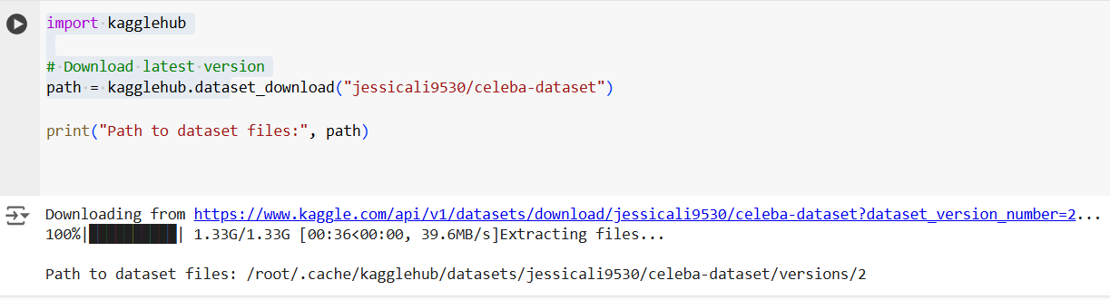
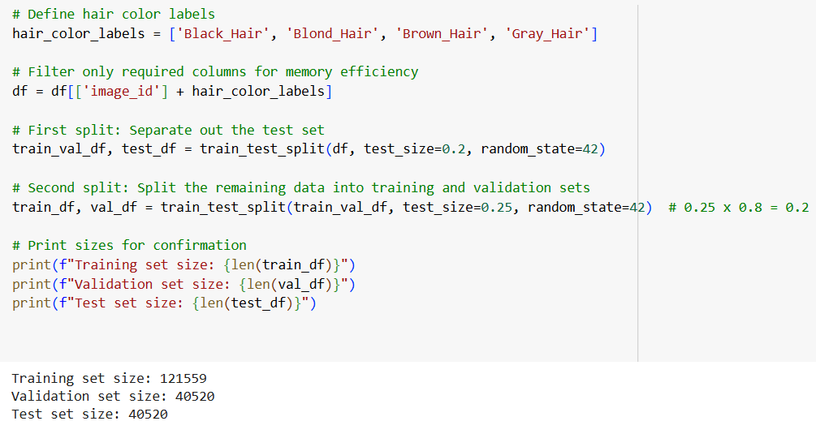
Methodology
Evidence of Completion
Hair Color Classification
Used kagglehub to download the "Dataset Hair Color."
Data pre-processing implemetation
Load annotations, filter relevant attributes, and split data into training, validation, and test sets.
IT21894824 | Prasadi S.A.D.T. | 24-25J-155
2/12/2024

Slide 23
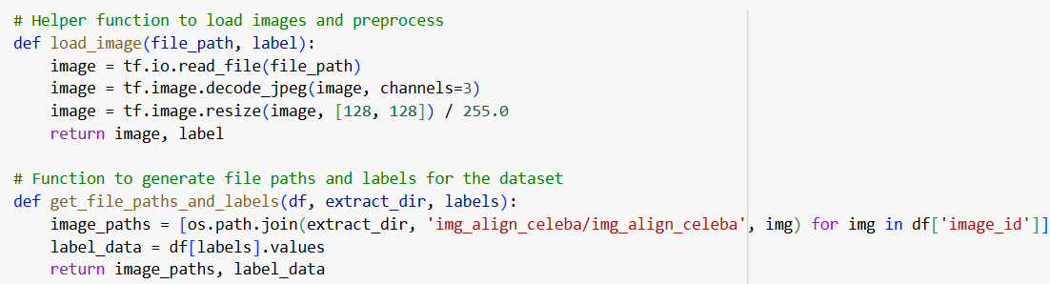
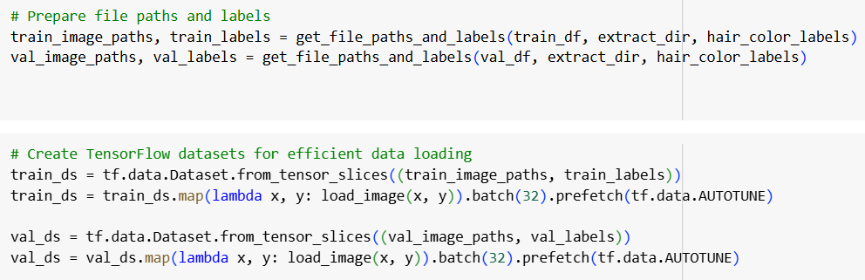
Methodology
Evidence of Completion
Hair Color Classification
Helper Functions for Image Processing
Define functions to preprocess images and generate file paths with corresponding labels.
Prepare TensorFlow datasets for training and validation.
IT21894824 | Prasadi S.A.D.T. | 24-25J-155
2/12/2024

Slide 24
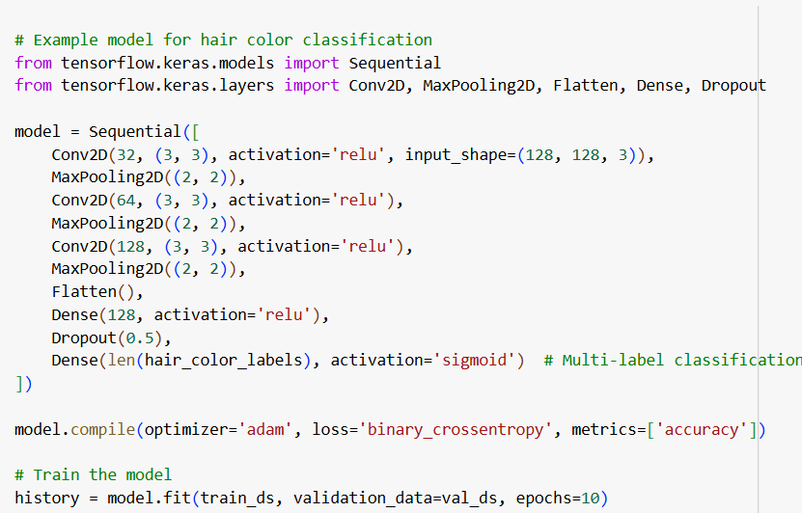
Methodology
Evidence of Completion
Hair Color Classification
Model Development and Train Build and compile a CNN model for multi-label hair color classification and Train the model using the training and validation datasets.
IT21894824 | Prasadi S.A.D.T. | 24-25J-155
2/12/2024

Slide 25
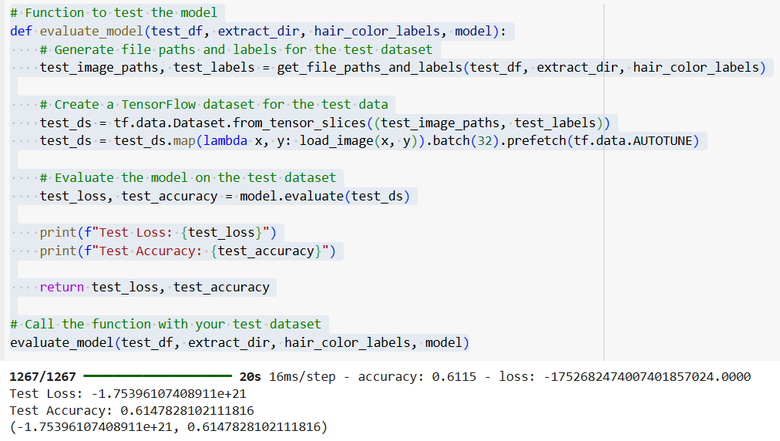
Methodology
Evidence of Completion
Hair Color Classification
Training Results:
Accuracy: 0.6115
Loss: -1.7526e+21
Evaluation Results:
Test Loss: -1.75396107408911e+21
Test Accuracy: 0.6147828102111816
IT21894824 | Prasadi S.A.D.T. | 24-25J-155
2/12/2024

Slide 26
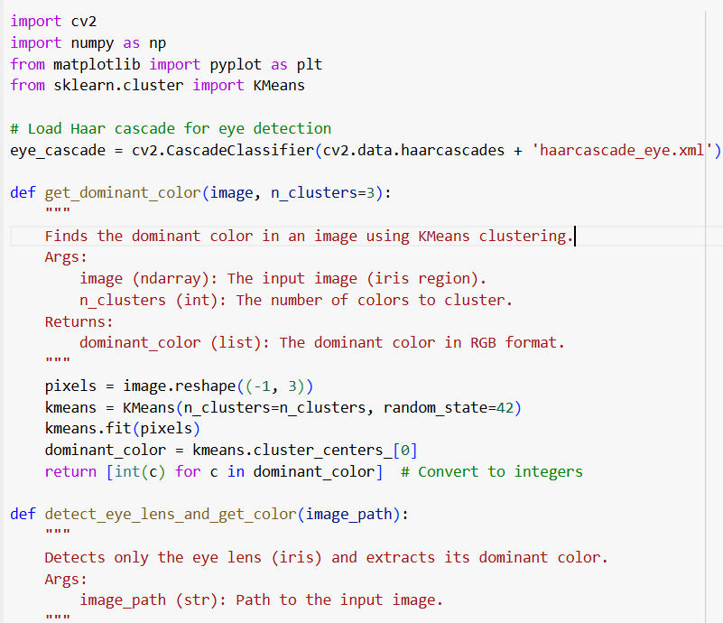
Methodology
Evidence of Completion
Eye Color Classification
Haar Cascade Classifier (for detecting the eyes).
haarcascade_eye.xml is a pre-trained XML file provided by OpenCV that uses the Haar-like features and Cascade Classifier algorithm.
IT21894824 | Prasadi S.A.D.T. | 24-25J-155
2/12/2024

Slide 27
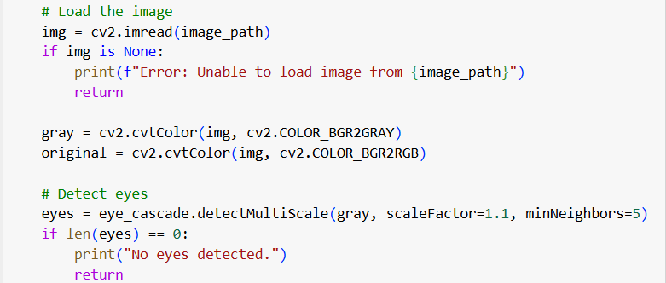
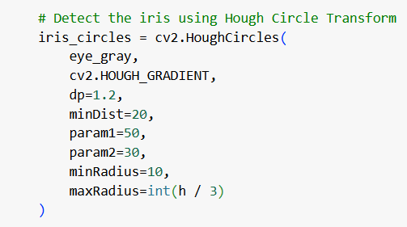
Methodology
Evidence of Completion
Eye Color Classification
Load and Convert the Image and Detect Eyes
The input image is loaded and converted into:
Grayscale (gray) for eye detection (required by Haar cascade).
RGB (original) for visualization.
Detect Iris Using Hough Circle Transform
IT21894824 | Prasadi S.A.D.T. | 24-25J-155
2/12/2024

Slide 28
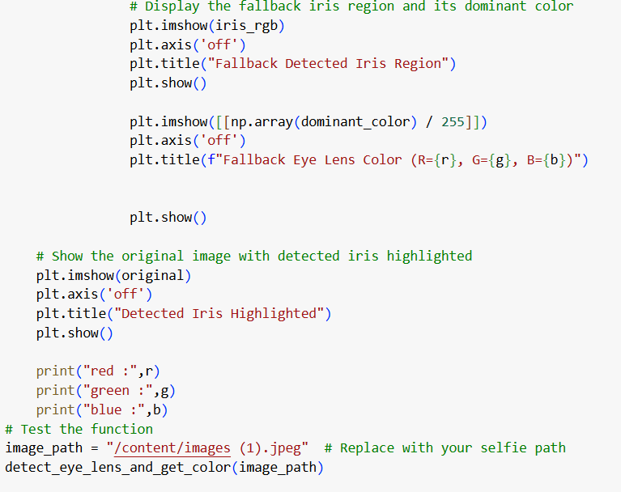
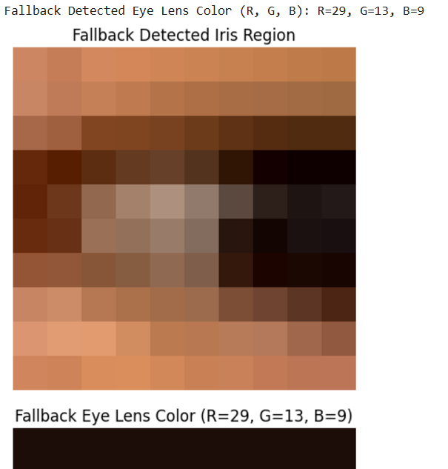
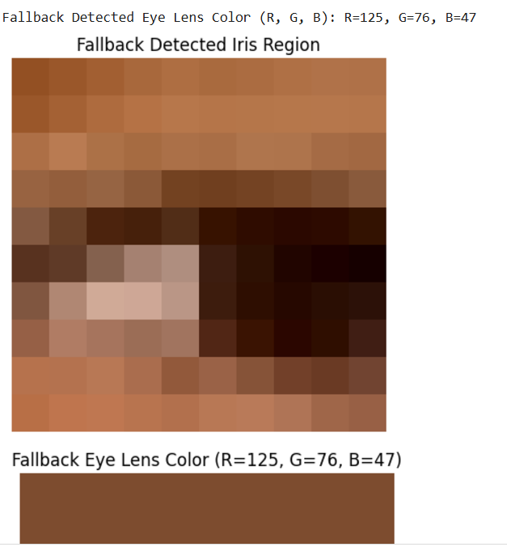
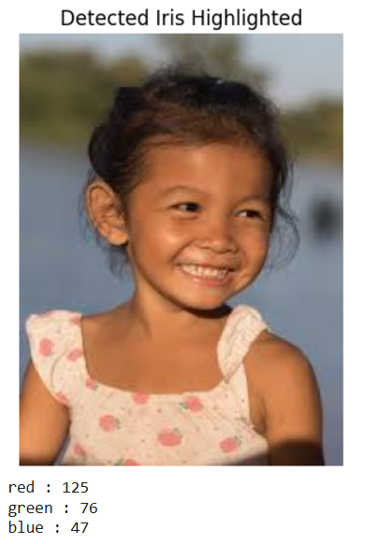
Methodology
Evidence of Completion
Eye Color Classification
-Load the selfie image.
-Detect the eye using Haar Cascade.
-Detect the iris within the eye using Hough Circle Transform (or fallback approximation).
-Extract the dominant color from the iris region using KMeans.
-Visualize and print the results
IT21894824 | Prasadi S.A.D.T. | 24-25J-155
2/12/2024

Slide 29
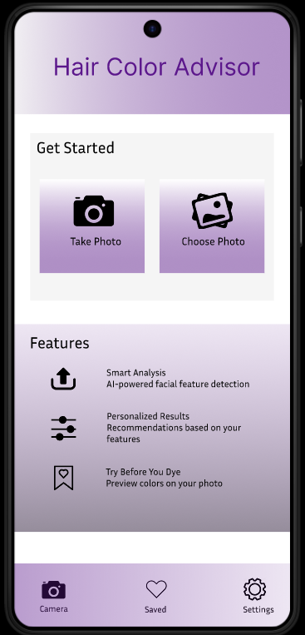
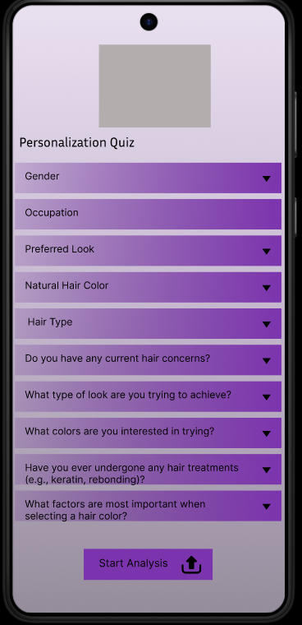
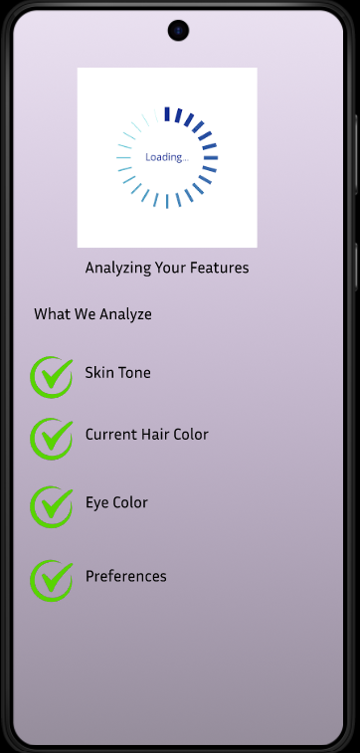
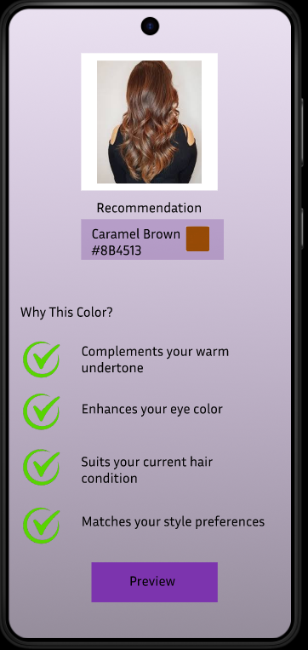
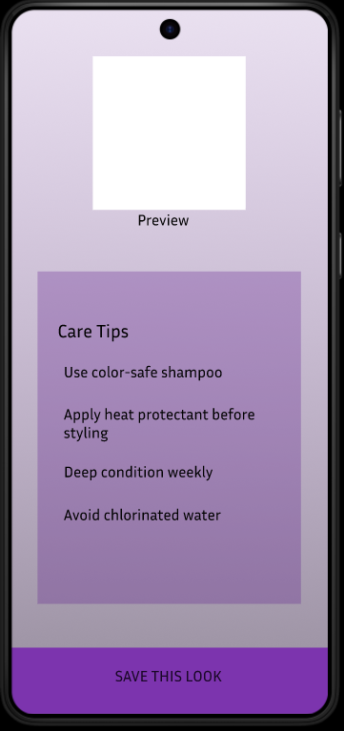
Display the results in mobile application
IT21894824 | Prasadi S.A.D.T. | 24-25J-155
2/12/2024

Slide 30
System, personal, and software Requirements specification
System Requirements
Operating Systems - The system must be compatible with Android and iOS operating systems.
Web Browsers - The system should be accessible through modern web browsers such as Google Chrome, Safari, and Firefox, ensuring compatibility with the latest versions of these browsers.
Internet Connection - The mobile app requires a stable internet connection to upload images, process data, and interact with the recommendation system in real-time.
IT21894824 | Prasadi S.A.D.T. | 24-25J-155
2/12/2024

Slide 31
Personal Requirements
Basic Photography Skills - Users should have the ability to take clear, well-lit photos of themselves using their mobile device, as the app relies on image quality for accurate feature extraction and recommendations.
Attention to Detail - Users should be attentive and precise when inputting personal details such as current hair condition, lifestyle preferences, and other relevant information, as these inputs significantly impact the accuracy of the recommendations.
Interest in Personal Style and Fashion - Users should have an interest in exploring new hair colors and styles, as the app is designed to help users experiment with and choose looks that enhance their personal style.
IT21894824 | Prasadi S.A.D.T. | 24-25J-155
2/12/2024

Slide 32
Software Specific Requirements
React Native
Python
Tensorflow
MongoDB
Node
IT21894824 | Prasadi S.A.D.T. | 24-25J-155
2/12/2024

Slide 33
Functional Requirements
Non-Functional Requirements
Allow users to upload photos and automatically detect features like skin tone, hair color, and eye color using deep learning.
Generate and display tailored hair color suggestions based on detected features and user preferences.
Enable users to apply and see recommended hair colors on their photos in real-time.
Allow users to provide feedback and adjust their preferences to improve future recommendations.
Higher Accuracy Of results.
Should properly work for IOS and Android devices.
Should have high security.
Application should be reliable.
Interfaces should be more user-friendly.
IT21894824 | Prasadi S.A.D.T. | 24-25J-155
8/10/2024

Slide 34
References
[1] J. Smith and R. Brown, "A Study on Hair Color Recommendation Systems," IEEE Transactions on Consumer Electronics, vol. 67, no. 2, pp. 34-42, March 2022.
[2] A. Johnson and M. Wang, "Advancements in Personalized Beauty Recommendations Using AI," IEEE Access, vol. 9, pp. 123456-123465, June 2021.
[3] L. Kim and J. Lee, "Deep Learning Applications in Fashion and Beauty Industry," IEEE Transactions on Multimedia, vol. 23, no. 6, pp. 23-34, November 2020
[4] R. Gonzalez, M. Rivera, and S. Park, "AI-Powered Personalization in Beauty Applications," IEEE Intelligent Systems, vol. 36, no. 4, pp. 56-63, July 2021.
[5] P. Nair and D. Kumar, "Real-Time Virtual Hair Color Try-On Using Deep Learning," IEEE Transactions on Image Processing, vol. 30, pp. 1567-1578, January 2021.
IT21894824 | Prasadi S.A.D.T. | 24-25J-155
2/12/2024

Slide 35
IT21322280 | Shaakir J.H.M
Specialization : Software Engineering
IT21322280 | Shaakir J.H.M | 24-25J-155
2/12/2024

Slide 36
Clothing Recommendations based on body type & skin tone
IT21322280 | Shaakir J.H.M | 24-25J-155
2/12/2024

Slide 37
INTRODUCTION
IT21322280 | Shaakir J.H.M | 24-25J-155
2/12/2024

Slide 38
Background
The advancement of AR technology has transformed the online shopping experience, allowing users to virtually try on clothes and see how they fit in real-time.
Many clothing recommendation systems have been developed, leveraging machine learning and computer vision to suggest outfits based on user preferences and behavior.
Most platforms offer limited customization, typically restricted to size and color options, without allowing detailed personalization of garment designs and patterns.
IT21322280 | Shaakir J.H.M | 24-25J-155
2/12/2024

Slide 39
Research Gap
Existing systems generally offer limited customization options, primarily focusing on recommending pre-designed garments without allowing users to personalize aspects such as designs, patterns, and colors.
While there is growing awareness of sustainable fashion, existing solutions rarely provide information or guidance on environmentally friendly materials and manufacturing practices.
There is a lack of features that educate users on how to make their clothing choices more sustainable, or how to convert their wardrobe into a more eco-friendly one.
Many virtual try-on platforms lack a social component, which could foster user interaction, sharing, and feedback within a community of fashion enthusiasts.
IT21322280 | Shaakir J.H.M | 24-25J-155
2/12/2024

Slide 40
How can a clothing recommendation system be developed that not only allows users to virtually try on outfits but also provides advanced customization options and comprehensive sustainability insights, while fostering a social environment for user interaction?
Research Problem
IT21322280 | Shaakir J.H.M | 24-25J-155
2/12/2024

Slide 41
Specific & Sub Objectives
Sub Objective
Specific Objective
To incorporate features that provide users with detailed information about the materials used in the apparel, including manufacturing processes and environmental impact.
To suggest tips on how users can make their clothing choices more sustainable and environmentally friendly.
To design the application with social media-like functionalities, allowing users to share their virtual fit-ons, interact with others, and receive real-time feedback, thereby creating a vibrant and engaging community.
To develop a clothing recommendation system with virtual fit-on capabilities using AR technology. To enable users to customize their chosen apparel in real-time by altering designs, patterns, and colors at a granular level
IT21322280 | Shaakir J.H.M | 24-25J-155
2/12/2024

Slide 42
PROPOSED METHODOLOGY
IT21322280 | Shaakir J.H.M | 24-25J-155
2/12/2024

Slide 43
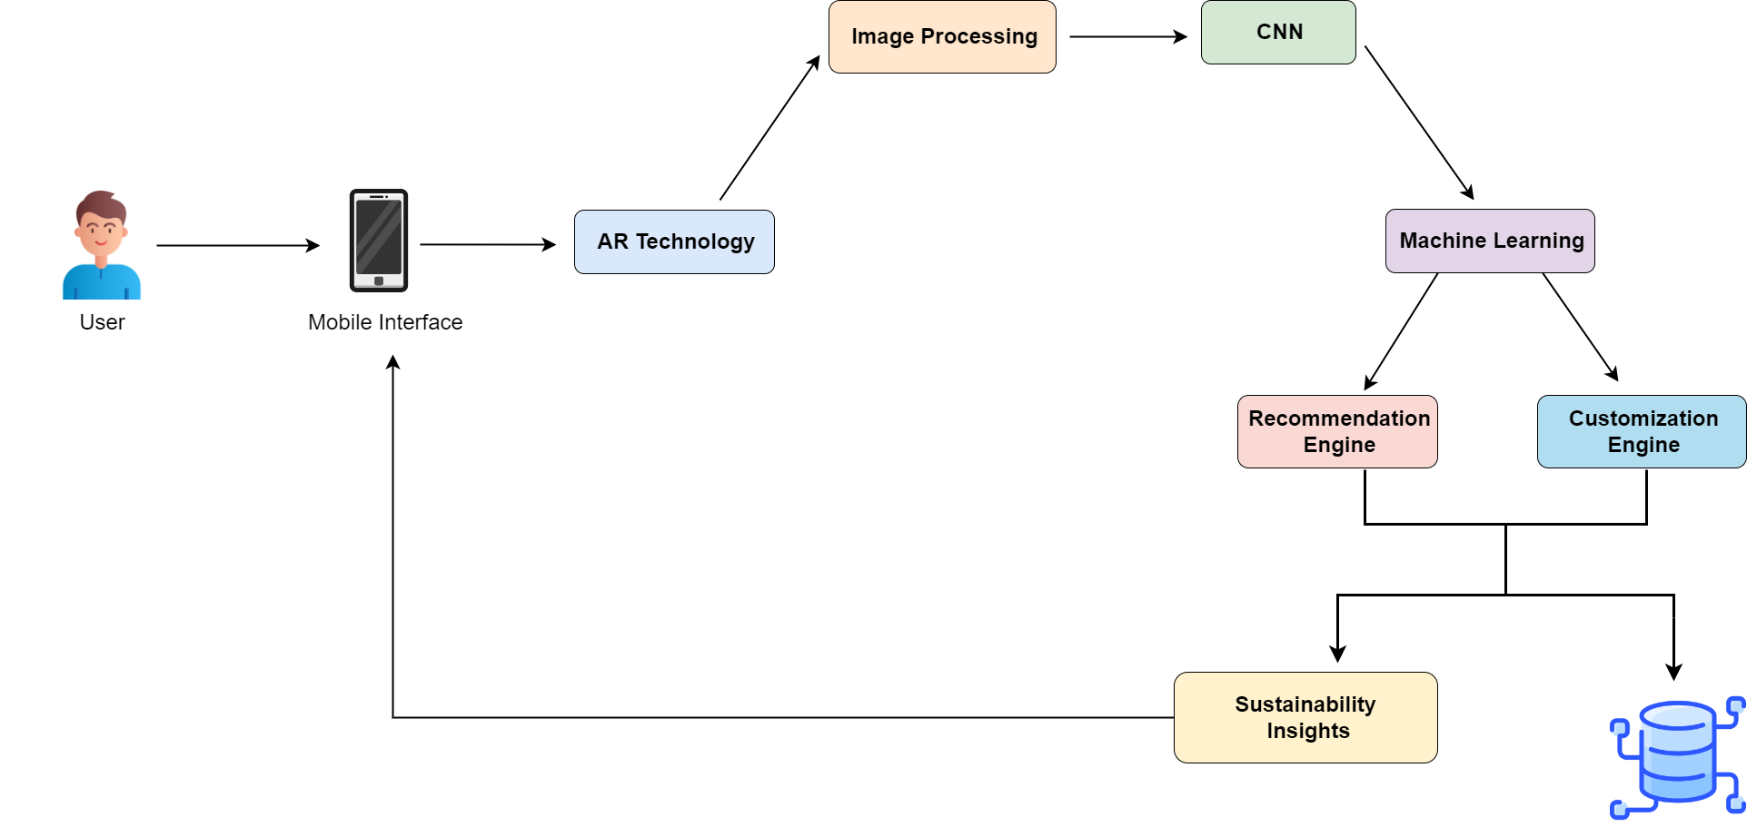
System Overview
IT21322280 | Shaakir J.H.M | 24-25J-155
2/12/2024

Slide 44
Technologies, Tools & Algorithms
Algorithms & Architectures
Technologies
Tools
React Native
Expo
Python
Tensorflow
MongoDB
Node
PyCharm
Google Colab
Kaggle
GitHub
Docker
VS Code
Random Forest Classifier
CNN
VGG 16
Image Processing
OpenCV
IT21322280 | Shaakir J.H.M | 24-25J-155
2/12/2024

Slide 45
Requirements
Functional
Non-Functional
Software
Enable users to try on selected clothes virtually using AR technology. Display detailed information about the materials used, manufacturing processes, and environmental impact of each garment. Provide personalized clothing recommendations based on wardrobe, search history, and user preferences.
Scalability
Performance
Security
Usability
Compatibility
Deep Learning Algorithms
Machine Learning Libraries
Development Tools
IT21322280 | Shaakir J.H.M | 24-25J-155
2/12/2024

Slide 46
COMPLETION OF
THE PROJECT
IT21322280 | Shaakir J.H.M | 24-25J-155
2/12/2024

Slide 47
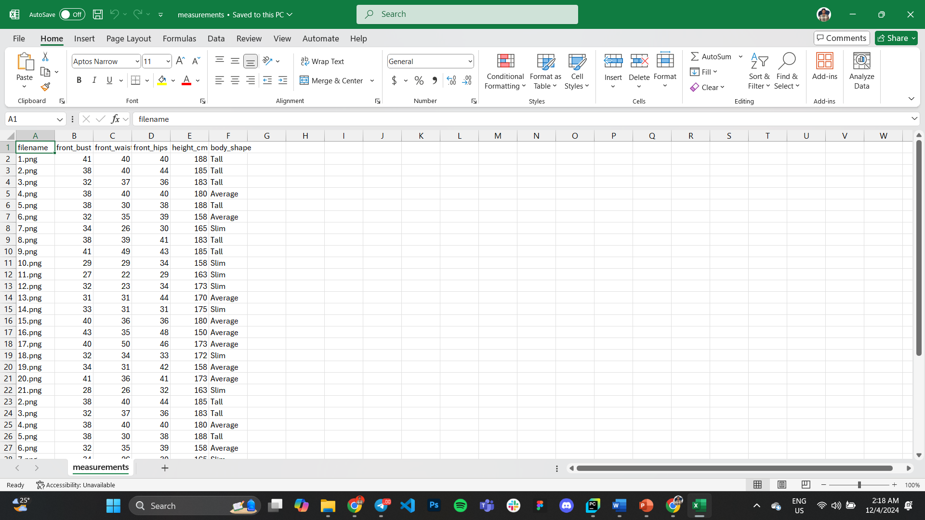
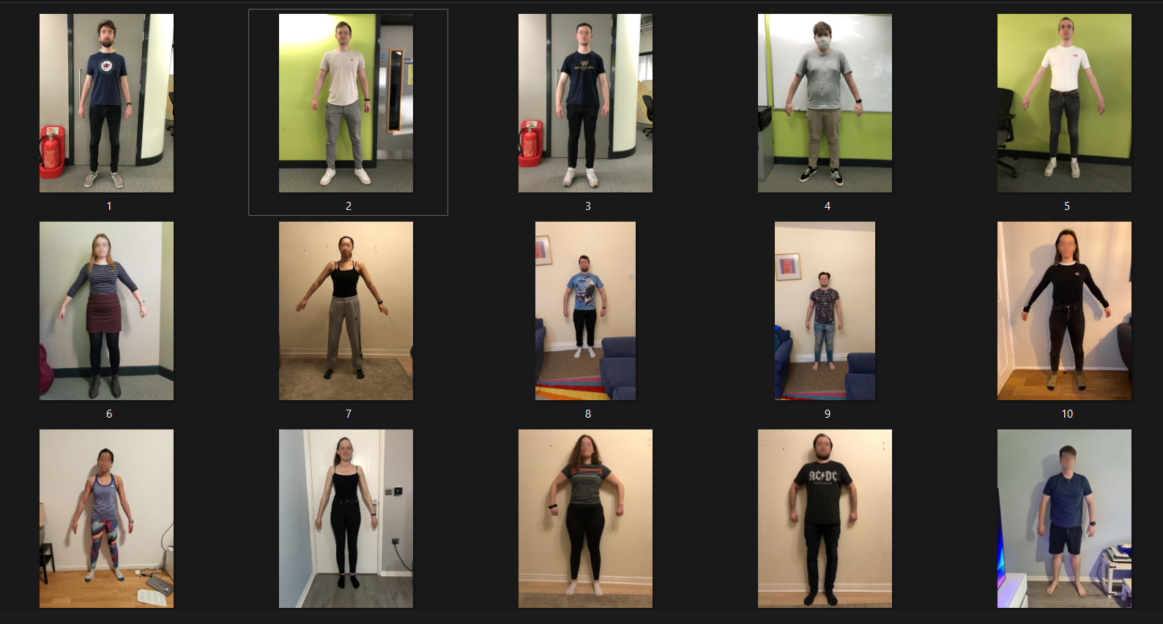
Data Collection
Collected dataset has images of various body types & different skin tones.
The dataset was collected from Newcastle University.
Also, it comes with a .csv file with measurements such as front bust, front waist, front hips, height & body shape.
IT21322280 | Shaakir J.H.M | 24-25J-155
2/12/2024

Slide 48
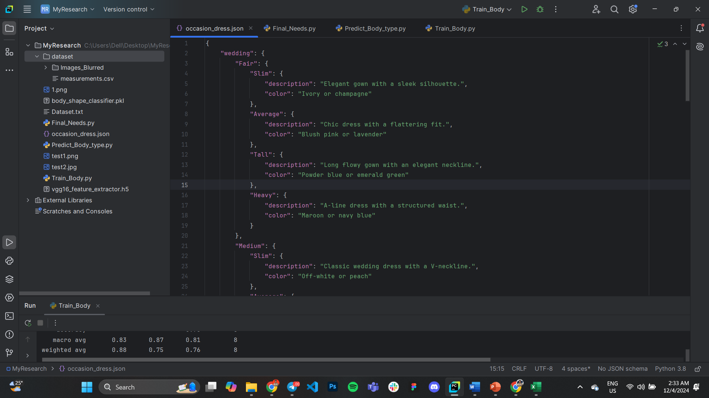
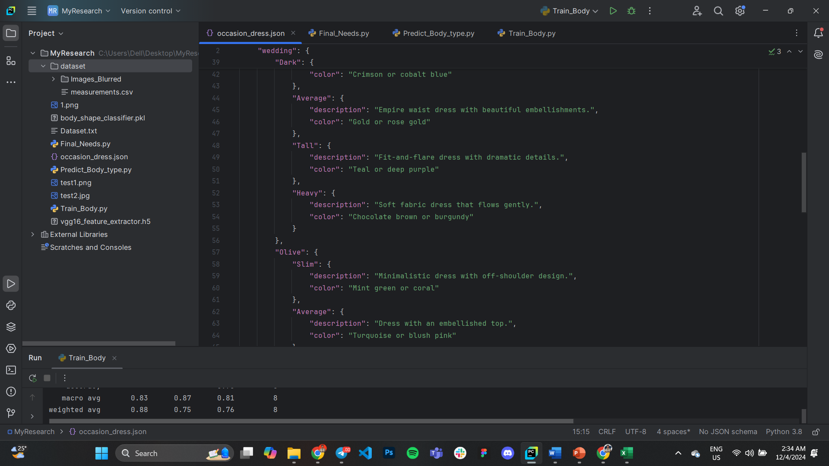
Data Collection
Based on occasion, skin tone & body type different output will be generated. Those outputs are stored in a .json file.
IT21322280 | Shaakir J.H.M | 24-25J-155
2/12/2024

Slide 49

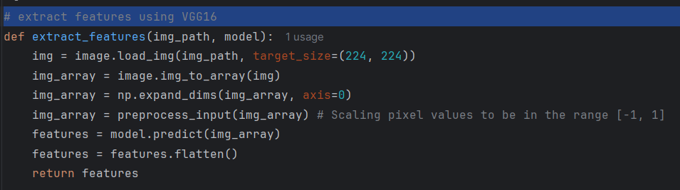
Model Training
I have used VGG16 as the architecture. It is an advanced version of CNNs.
It consists of 16 layers, including 13 convolutional layers and 3 fully connected layers.
It uses Softmax as the activation function, to ensure the cumulative outcome probability is 1.
Image gets load into the function and then pre processing happens, followed by feature extraction
IT21322280 | Shaakir J.H.M | 24-25J-155
2/12/2024

Slide 50
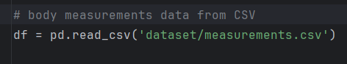
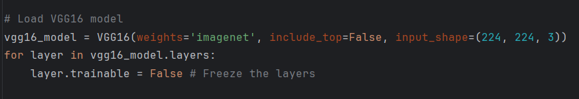
Model Training
Reads tabular data from .csv file
Loads VGG16 Model
IT21322280 | Shaakir J.H.M | 24-25J-155
2/12/2024

Slide 51
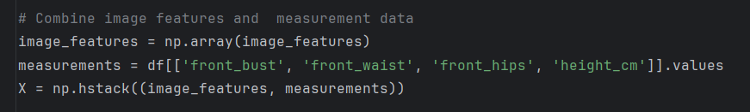
Model Training
Combines the features extracted using VGG16 and data read from .csv file
Encodes the body shape labels into numerical values to make them compatible with machine learning algorithms.
Dataset is split into training (80%) & testing (20%)
IT21322280 | Shaakir J.H.M | 24-25J-155
2/12/2024

Slide 52
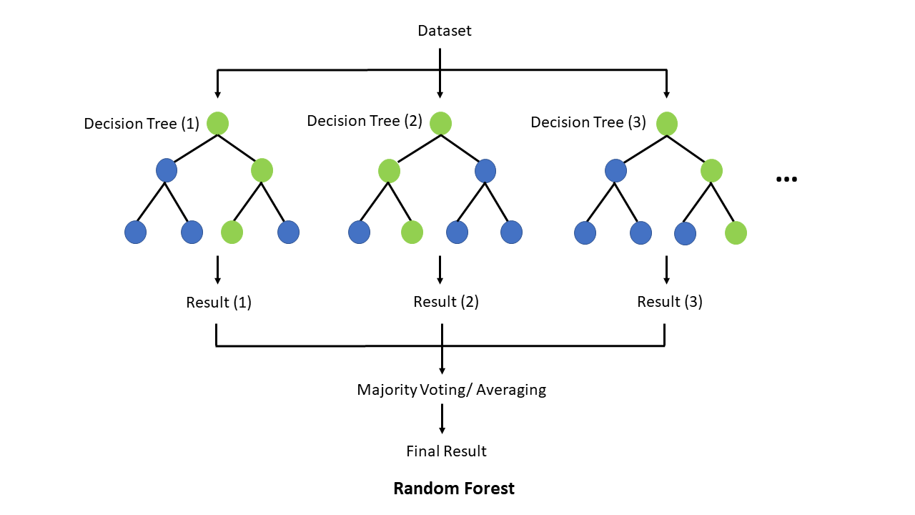
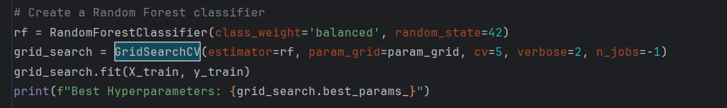
Model Training
I have used Random Forest Classifier (RFC) for body shape classification.
It is a supervised machine learning algorithm.
Hyper parameter tuning is used in RFC.
IT21322280 | Shaakir J.H.M | 24-25J-155
2/12/2024

Slide 53
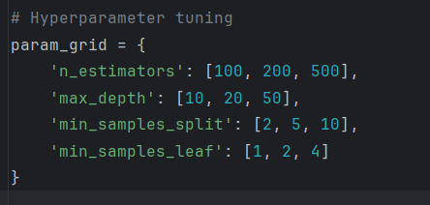
Model Training
This defines the hyperparameters that needs to be tuned
IT21322280 | Shaakir J.H.M | 24-25J-155
2/12/2024

Slide 54
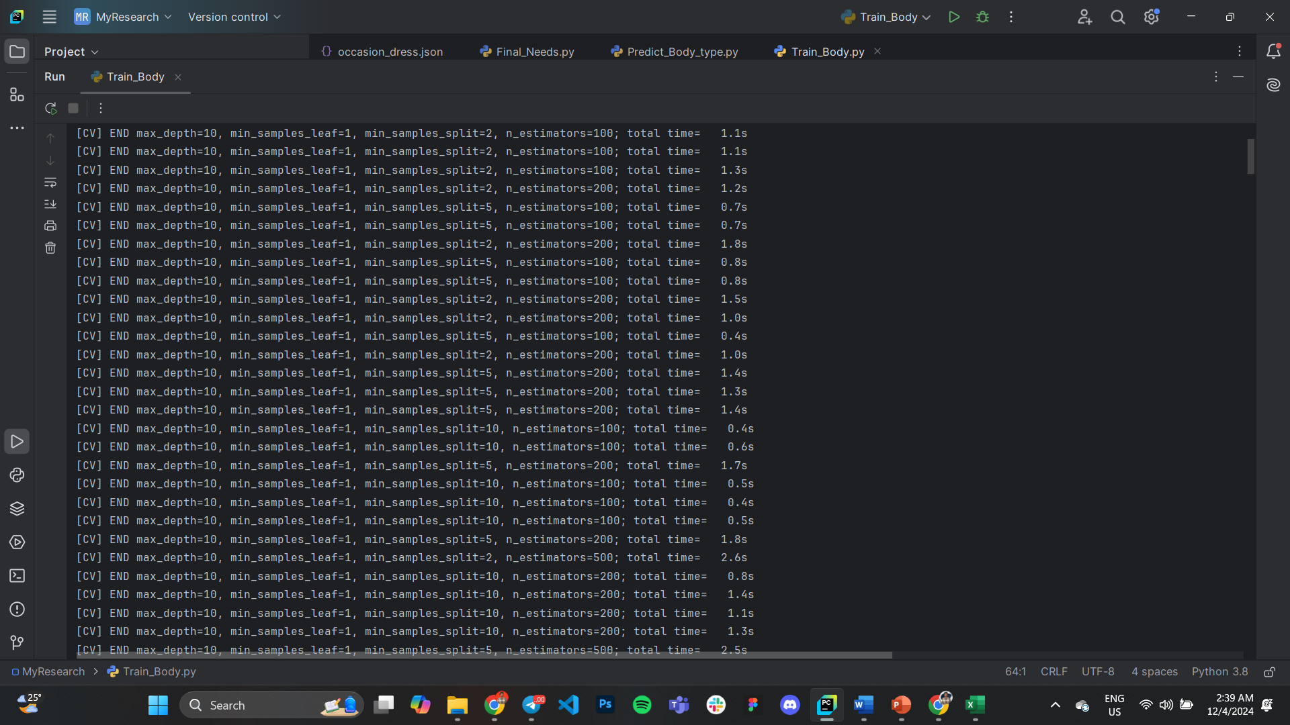
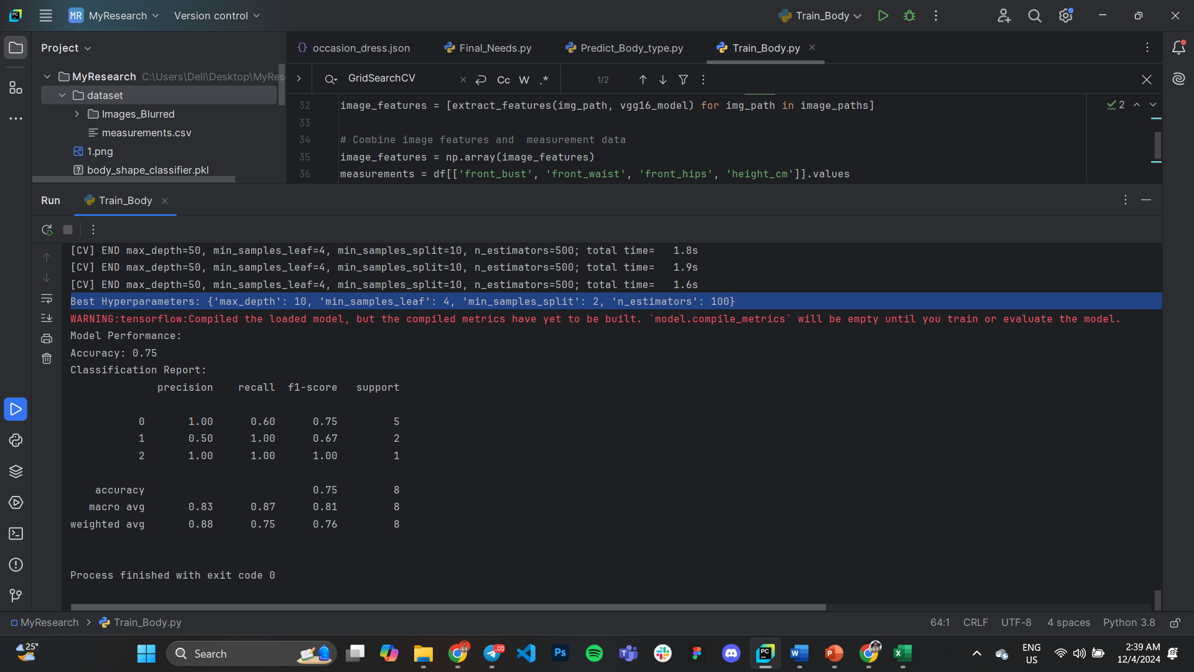
Model Training
Finds out the optimal hyper parameters and displays it
IT21322280 | Shaakir J.H.M | 24-25J-155
2/12/2024

Slide 55
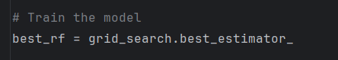
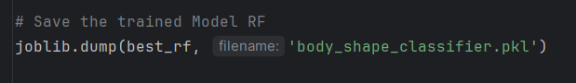
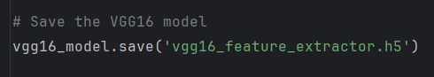
Model Training
Trains the best RFC model
Saves the RFC model
Saves the VGG16 model
IT21322280 | Shaakir J.H.M | 24-25J-155
2/12/2024

Slide 56


Model Training
Evaluates the model performance
Model gets an accuracy of 75%
IT21322280 | Shaakir J.H.M | 24-25J-155
2/12/2024

Slide 57

Model Training
Classification Report
IT21322280 | Shaakir J.H.M | 24-25J-155
2/12/2024

Slide 58


Output Prediction
Loads a JSON file that presumably contains a mapping between different occasions and suitable dresses for those occasions.
Loads the previously trained Random Forest Classifier model to predict the body type.
IT21322280 | Shaakir J.H.M | 24-25J-155
2/12/2024

Slide 59


Output Prediction
Loads the image using OpenCV
Converts the image into RGB
Loads the pre-trained Haar Cascade classifier for face detection.
Converts the image into grayscale and detects for faces.
IT21322280 | Shaakir J.H.M | 24-25J-155
2/12/2024

Slide 60

Output Prediction
Skin Tone Detection
IT21322280 | Shaakir J.H.M | 24-25J-155
2/12/2024

Slide 61


Output Prediction
Predict the body type using Random Forest Classifier
This dictionary maps the numerical predictions (from the Random Forest model) to human-readable labels
IT21322280 | Shaakir J.H.M | 24-25J-155
2/12/2024

Slide 62

Output Prediction
Prints the output
IT21322280 | Shaakir J.H.M | 24-25J-155
2/12/2024

Slide 63


Output Prediction
Sample Input 01
Predicted Outcome
test1.png
IT21322280 | Shaakir J.H.M | 24-25J-155
2/12/2024

Slide 64


Output Prediction
Sample Input 02
Predicted Outcome
1.png
IT21322280 | Shaakir J.H.M | 24-25J-155
2/12/2024

Slide 65



Output Prediction
Sample Input 03
Predicted Outcome
khaby1.png
IT21322280 | Shaakir J.H.M | 24-25J-155
2/12/2024

Slide 66
References
[1] S. Shete, H. Darshan, M. Thakare and K. Dhuri, "AI based Fashion Stylist Recommendation System," 2024 11th International Conference on Computing for Sustainable Global Development (INDIACom), New Delhi, India, 2024, pp. 697-701, doi: 10.23919/INDIACom61295.2024.10498329.
[2] S. Elsawaf and A. Barbar, "Online Fitting Room: A Mobile Shopping Application using Augmented Reality (AR) Technology," 2023 18th International Joint Symposium on Artificial Intelligence and Natural Language Processing (iSAI-NLP), Bangkok, Thailand, 2023, pp. 1-5, doi: 10.1109/iSAI-NLP60301.2023.10354859.
[3] A. Mishra, S. Kaintura, Y. S. Yadav, V. Joshi, H. Vaidya and A. Kapruwan, "GANs and Augmented Reality in Virtual Clothing Try-On," 2024 International Conference on Intelligent and Innovative Technologies in Computing, Electrical and Electronics (IITCEE), Bangalore, India, 2024, pp. 1-6, doi: 10.1109/IITCEE59897.2024.10467813.
[4] L. Sivaranjani, S. K. Rachamadugu, B. V. S. Reddy, B. R. A, M. Sakthivel and S. Depuru, "Fashion Recommendation System Using Machine Learning," 2023 4th International Conference on Smart Electronics and Communication (ICOSEC), Trichy, India, 2023, pp. 1367-1374, doi: 10.1109/ICOSEC58147.2023.10275967.
IT21322280 | Shaakir J.H.M | 24-25J-155
2/12/2024

Slide 67
IT21180798 | Vikasitha M.K.I.
Specialization: Information Technology
IT21180798 | Vikasitha M.K.I. | 24-25J-155
2/12/2024

Slide 68
Hair Style Transformation and Realistic Simulation for Personalized Recommendations
IT21180798 | Vikasitha M.K.I. | 24-25J-155
2/12/2024

Slide 69
Introduction
Importance: Offers significant value by providing users with personalized, realistic, and culturally sensitive hair styling options.
Requirement of hairstyle simulator: Traditional systems often deliver generic hairstyle recommendations based on popularity or purchase history, lacking personalized, nuanced suggestions and failing to integrate comprehensive hairstyle advice.
Benefits: Ability to try hairstyles in real-time and choose one that matches the individual's face shape and regional characteristics
IT21180798 | Vikasitha M.K.I. | 24-25J-155
2/12/2024

Slide 70
Background
Human races are traditionally categorized into groups like Caucasian/White, Mongoloid/Asian, Negroid/Black, and Australoid, though these distinctions are considered social constructs rather than biologically distinct groups. [1]
Hairstyles vary widely across cultures and eras, serving as expressions of identity, influenced by factors such as social status, ethnicity, fashion trends, and personal taste. [2]
Barbers traditionally identify suitable hairstyles for individuals based on face shapes—such as oval, round, square, heart, and diamond, using experience and knowledge passed down through practice. [3]
IT21180798 | Vikasitha M.K.I. | 24-25J-155
2/12/2024

Slide 71

When and where to use image processing while detecting the person’s region?
How many resources and machine learning or deep learning models are required to identify the region and face shapes?
What are the technologies required to present real-time hairstyles that match the face shape?
How to develop and implement deep learning models running in optimal conditions with minimal resource components
Research Problem
IT21180798 | Vikasitha M.K.I. | 24-25J-155
2/12/2024

Slide 72
Specific and Sub Objective
Sub Objectives
Specific Objective
Identify human race by using image classification.
Face shape detection model
Hairstyle suggestion
Generate appropriate hairstyle for user using Generative Adversarial Network
Hair Style Transformation and Realistic Simulation for Personalized Recommendations
IT21180798 | Vikasitha M.K.I. | 24-25J-155
2/12/2024

Slide 73


Methodology
System Diagram
IT21180798 | Vikasitha M.K.I. | 24-25J-155
2/12/2024

Slide 74


Models
Human Race Detection Model
1. Identifying human race using image classification
CNN Architecture - VGG16
5 classes
7000 over images
Face Shape Detection Model
1. Identifying human face shape using image classification
XGBClassifier - XGBoost model
4 classes
1500 over images
IT21180798 | Vikasitha M.K.I. | 24-25J-155
2/12/2024

Slide 75




How to train Model 01
Requirements
JupyterLab (Anaconda Navigator)
Python Version – 3.9.2
CNN Architecture – VGG16
Dataset - images
Steps
IT21180798 | Vikasitha M.K.I. | 24-25J-155
2/12/2024

Slide 76


Build the Complete Model
IT21180798 | Vikasitha M.K.I. | 24-25J-155
2/12/2024

Slide 77


Graphs
IT21180798 | Vikasitha M.K.I. | 24-25J-155
2/12/2024

Slide 78


Classification Report & Confusion Matrix
IT21180798 | Vikasitha M.K.I. | 24-25J-155
2/12/2024

Slide 79

Output Prediction
IT21180798 | Vikasitha M.K.I. | 24-25J-155
2/12/2024

Slide 80
How to train Model 02
Requirements
JupyterLab (Anaconda Navigator)
Python Version – 3.9.2
CNN Architecture – VGG16
Dataset - images
Steps
IT21180798 | Vikasitha M.K.I. | 24-25J-155
2/12/2024

Slide 81


Build the Complete Model
IT21180798 | Vikasitha M.K.I. | 24-25J-155
2/12/2024

Slide 82


Graphs
IT21180798 | Vikasitha M.K.I. | 24-25J-155
2/12/2024

Slide 83


Classification Report & Confusion Matrix
IT21180798 | Vikasitha M.K.I. | 24-25J-155
2/12/2024

Slide 84

Output Prediction
IT21180798 | Vikasitha M.K.I. | 24-25J-155
2/12/2024

Slide 85




Completion and Future works
Identify human race by using image classification.
Face shape detection model
Hairstyle suggestion
Generate appropriate hairstyle for user using Generative Adversarial Network
IT21180798 | Vikasitha M.K.I. | 24-25J-155
2/12/2024

Slide 86
Technologies, Tools & Algorithms
Techniques & Infrastructure
Algorithms & Architectures
Technologies
Python
JavaScript
TensorFlow
OpenCV
React Native
React
Image Processing
Data Analytics
Cloud(Aws , Docker)
Version Control (Git)
Google Colab
Kaggle
CNN
Support Vector Machine (SVM)
VGG16
ResNet
IT21180798 | Vikasitha M.K.I. | 24-25J-155
2/12/2024

Slide 87
Personal Requirement
Functional Requirement
Non - Functional Requirement
User Profiles should store personal preferences, face shape information, and hairstyle history.
The system should accurately detect and classify face shapes using image processing techniques.
Based on detected face shape and regional characteristics, the system should recommend suitable hairstyles.
Resources and Database of human race
Resources and Database of human hair
Mr. Chandana (Fashion designer)
Interface should be user-Friendly
The system should be highly reliable.
Higher accuracy of results.
The system should be highly availability.
The system should be accurate
IT21180798 | Vikasitha M.K.I. | 24-25J-155
2/12/2024

Slide 88
Commercialization
Target Audience :
Domestic Small-Scale Babar.
Mobile application is free for all users and when reach relevant download enable google adsense.

Slide 89
References
S. M. Garn, "Human Races: Myth or Reality?" American Anthropologist, vol. 65, no. 5, pp. 1302-1303, Oct. 1963, doi: 10.1525/aa.1963.65.5.02a00300. [1]
R. B. Lee, "Hairstyles as Cultural Indicators: A Study of Male Hairstyles among African-American Youth," Journal of Black Studies, vol. 28, no. 3, pp. 359-374, Jan. 1998, doi: 10.1177/002193479802800306 [2]
A. M. R. Rowden and S. Wright, "The Influence of Facial Shape on Hair Styling," International Journal of Cosmetology, vol. 14, no. 1, pp. 25-30, Mar. 2010, doi: 10.1002/ijc.2010.03.025. [3]
Hair modeling and simulation based on a single-view picture Binbin Zhou1) , Zhigeng Pan1), Mingmin Zhang2) （1Hangzhou Normal University, Hangzhou, 311121 ( 2Zhejiang University, Hangzhou, 310058) [4]
Integrated Multi-Model Face Shape and Eye Attributes Identification for Hair Style and Eyelashes Recommendation Theiab Alzahrani 1 , Waleed Al-Nuaimy 1,* and Baidaa Al-Bander 2 [5]
[pdf] A Hybrid Approach to Building Face Shape Classifier for Hairstyle Recommender System. [6]
Hairstyle Recommendation Based on Face Shape Using Image Processing. September 2018 Conference: 11th International Research Conference General Sir John Kotelawala Defence University At: Sri Lanka [7]
IT21180798 | Vikasitha M.K.I. | 24-25J-155
2/12/2024

Slide 90
IT21213144 | Senarathne D.R
Specialization : Information Technology
IT21213144 | Senarathne D.R. | 24-25J-155
2/12/2024

Slide 91
Skin Tone Identification and Makeup Recommendation
IT21213144 | Senarathne D.R. | 24-25J-155
2/12/2024

Slide 92
INTRODUCTION
Background
Skin tone identification and makeup recommendation systems are innovative AI-driven tools designed to simplify the process of finding cosmetic products that match an individual’s unique complexion. These technologies aim to personalize the beauty experience by offering accurate and efficient recommendations tailored to diverse skin tones.
IT21213144 | Senarathne D.R. | 24-25J-155
2/12/2024

Slide 93
Importance of Skin Tone Detection
Human skin tones come in many different shades, affected by factors like genetics, where a person lives, and their surroundings. The first step in giving users makeup recommendations that match their natural look is to correctly identify their skin tone, which is usually grouped into fair, medium, or dark categories.
How Makeup Recommendations Work
After figuring out the skin tone, the system recommends products like foundations, concealers, and other cosmetics that suit the user's skin. It does this by comparing the skin tone with a product database, making sure the recommendations match undertones such as warm, cool, or neutral.
IT21213144 | Senarathne D.R. | 24-25J-155
2/12/2024

Slide 94
Dataset Bias : The model may not work well for all skin tones because the data used for training doesn't include enough variety.
Variations in Skin Tone: Different lighting and camera qualities can make it hard to get accurate results for skin tone identification.
Inconsistent Labels: People use different ways to describe skin tones, making it hard to agree on one system.
Makeup Matching: Finding the right makeup is tough because it needs to consider more than just skin tone, like undertones.
Research Problem
IT21213144 | Senarathne D.R. | 24-25J-155
2/12/2024

Slide 95
Specific & Sub Objectives
Specific Objective
Sub Objective
Develop a Skin Tone Classification System: Build a machine learning model that can correctly identify a person’s skin tone (fair, medium, or dark) from an image. This system will help give more personalized and inclusive makeup recommendations.
Recommend Foundation Shades: Develop a smart system that suggests the best foundation shades based on the skin tone detected. The system should provide accurate and diverse suggestions to match different skin tones.
Data Collection and Labeling: Collect a wide range of images showing different skin tones and make sure each image is labeled correctly. This will help train the model. Both manual and automatic methods will be used for labeling.
Model Optimization and Testing: Improve the trained model to make it more accurate, ensuring it works well with new, unseen data. This involves using methods like adding more data and testing it in different ways.
IT21213144 | Senarathne D.R. | 24-25J-155
2/12/2024

Slide 96

METHODOLOGY
System Overview Diagram
IT21213144 | Senarathne D.R. | 24-25J-155
2/12/2024

Slide 97
Technologies,Tools & Algorithms
Technologies
TensorFlow
Google Colab
Keras
Python
React Native
Tools
Algorithms
Flask
OpenCV
Kaggle
Github
VS code
Softmax Activation
CNN
Transfer Learning
Image processing
IT21213144 | Senarathne D.R. | 24-25J-155
8/10/2024

Slide 98
Functional and Non Functional Requirements
Functional Requirements
Non Functional Requirements
Skin Tone Classification: The system should accurately classify the user's skin tone into categories such as fair, medium, and dark based on an uploaded image.
Foundation Shade Recommendation: The system should recommend suitable foundation shades that match the identified skin tone.
Image Processing: The system must preprocess and resize images for effective classification using deep learning models.
User Interface (UI): A mobile app or web interface should allow users to upload images and receive foundation shade recommendations.
Accuracy: The model must classify skin tones with a high level of accuracy to ensure reliable foundation recommendations.
Performance: The system should process images and provide recommendations in real-time or within a few seconds.
Scalability: The system should handle a growing number of users and images as more data is collected.
Usability: The application should have an intuitive user interface that is easy to navigate for people with little to no technical knowledge.
IT21213144 | Senarathne D.R. | 24-25J-155
2/12/2024

Slide 99


Model Setup
Data Augmentation
IT21213144 | Senarathne D.R. | 24-25J-155
2/12/2024

Slide 100


Completion of the project
Data Collection
IT21213144 | Senarathne D.R. | 24-25J-155
2/12/2024

Slide 101

Model Training
IT21213144 | Senarathne D.R. | 24-25J-155
2/12/2024

Slide 102


Testing code and Display results
IT21213144 | Senarathne D.R. | 24-25J-155
2/12/2024

Slide 103
References
Silva, A., Montazzoli, F., & Lima, M. (2022). Skin Color Classification Using Convolutional Neural Networks. IEEE Transactions on Image Processing. Available at: https://ieeexplore.ieee.org/document/9409428
Thomas, T. J., & Lee, S. (2023). Deep Learning-Based Skin Tone Classification for Personalized Beauty Applications. International Journal of Computer Vision. Available at: https://link.springer.com/article/10.1007/s11263-022-01632-w
Nguyen, L. T., & Brown, A. G. (2022). Enhanced Skin Tone Classification Using Lab Color Space. Pattern Recognition Letters. Available at: https://www.sciencedirect.com/science/article/pii/S0167865522001556
Patel, K. N., & Zhao, M. S. (2023). Datasets for Skin Tone Classification: A Review. Data Science and Engineering. Available at: https://link.springer.com/article/10.1007/s41040-023-00156-2
Walker, M. J., & Smith, E. F. (2023). Transfer Learning Approaches for Accurate Skin Tone Classification. IEEE Access. Available at: https://ieeexplore.ieee.org/document/10203456
IT21213144 | Senarathne D.R. | 24-25J-155
2/12/2024

Slide 104
Q & A
Progress Presentation 1
24-25J-155
2/12/2024

Slide 105
Thank You!
Progress Presentation 1
24-25J-155
2/12/2024

